Slide 1

Inverse Design of Metamaterials with Machine Learning Methods
University of California ▪ Los Angeles
Christopher Yeung
November 04, 2019

Slide 2
Introduction

Slide 3
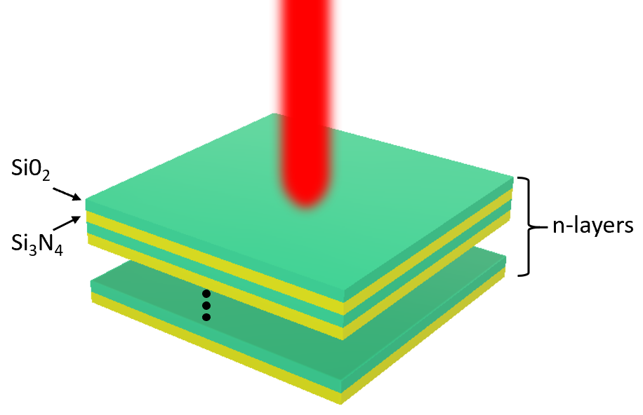
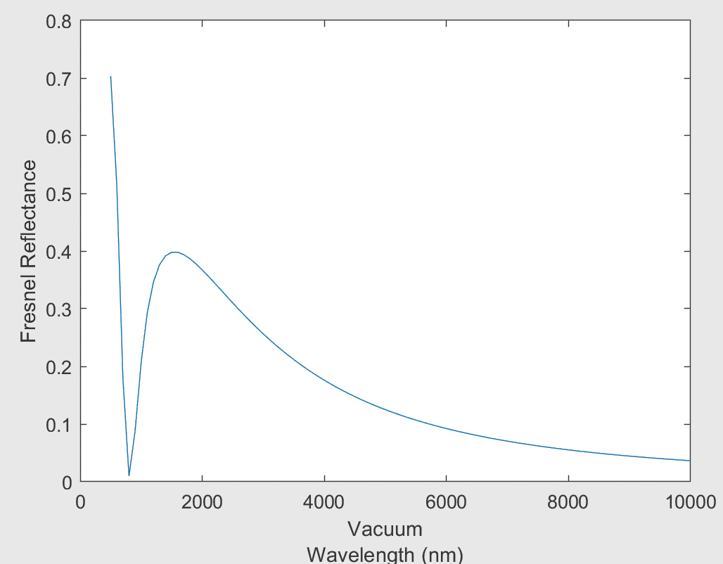
Lab and Research Introduction
Tackling Challenges in Metamaterial Design with Machine Learning
Current design methodologies are:
Time-consuming and computationally expensive.
“Forward design” methods (e.g., finite element analysis)*
Requires significant “trial-and-error” and intuition.
Potentially hundreds of iterations before obtaining desired results.
“Inverse design” (e.g., genetic algorithm and adjoint method)**
Likely to miss locally optimal designs.
Require specialized knowledge and complex derivations/implementations.
Forward Design
Inverse Design
*Yao, K., et al. Intelligent nanophotonics: Merging photonics and artificial intelligence at the nanoscale. Nanophotonics (2019).
**Molesky, S. et al. Inverse design in nanophotonics. Nature Photonics (2018)

Slide 4
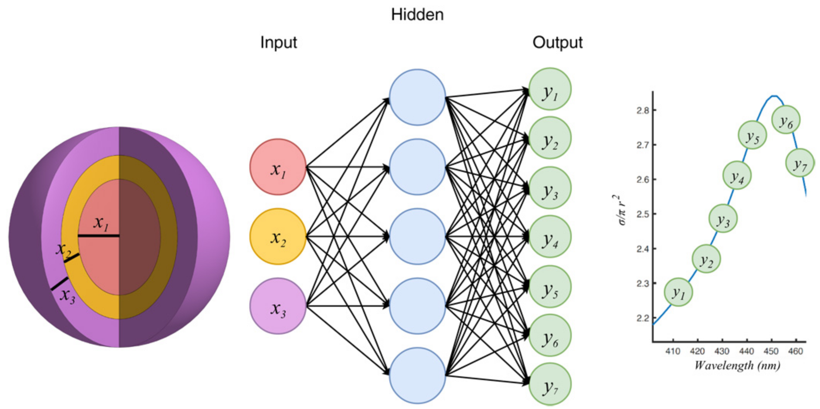
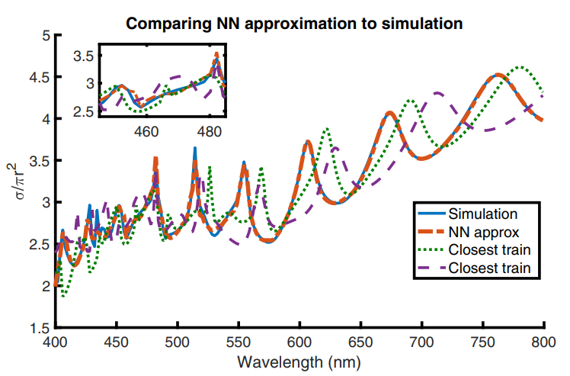
Lab and Research Introduction
Addressing Current Challenges
What if we use machine learning (ML) to help us generate designs?
ML-based methods can:
Accomplish design goals in a fraction of a second.
Doesn’t require iterative optimization.
Have little computational costs needed to perform calculations.
Yield complex/novel designs not previously conceived by human intuition.
To some extent, generalize the physics of the system.
a)
b)
2018 MIT study on artificial neural networks for designing photonic nanoparticles. a) Concept schematic. b) NN approximation vs simulation*.
*J. Peurifoy, et al., Nanophotonic Particle Simulation and Inverse Design Using Artificial Neural Networks, Science Advances, 2018.

Slide 5
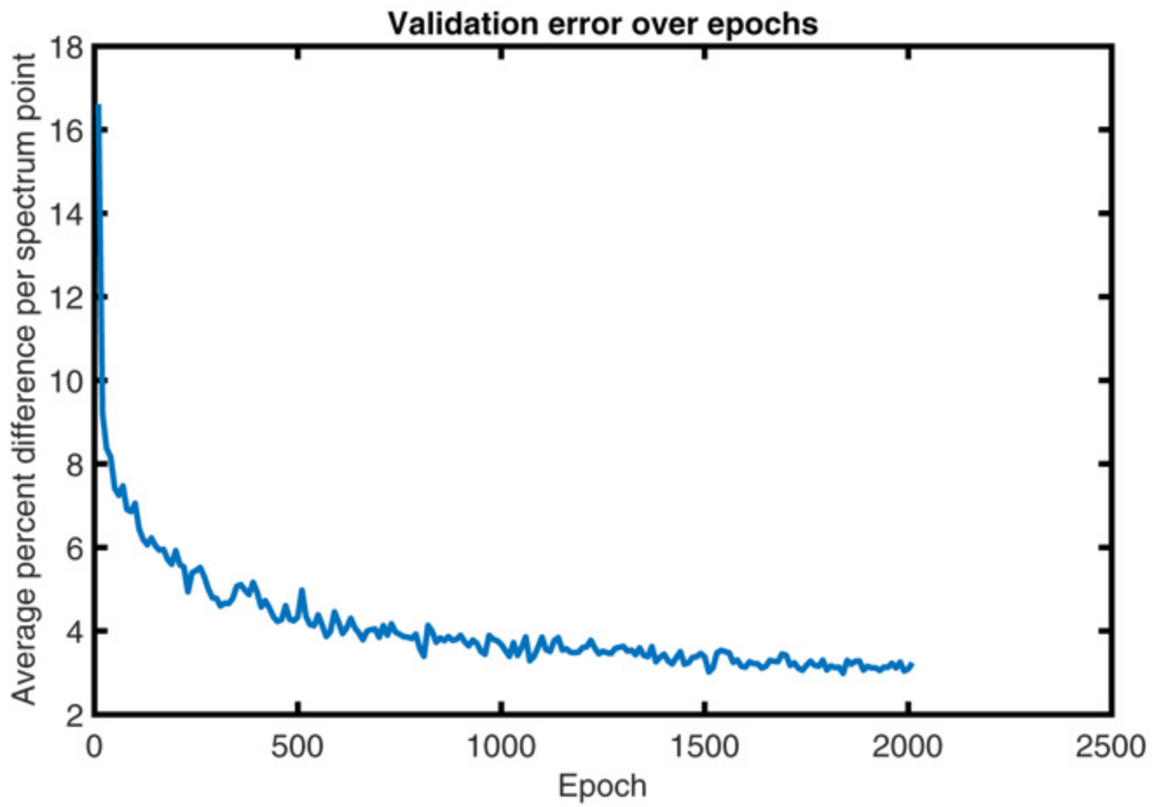
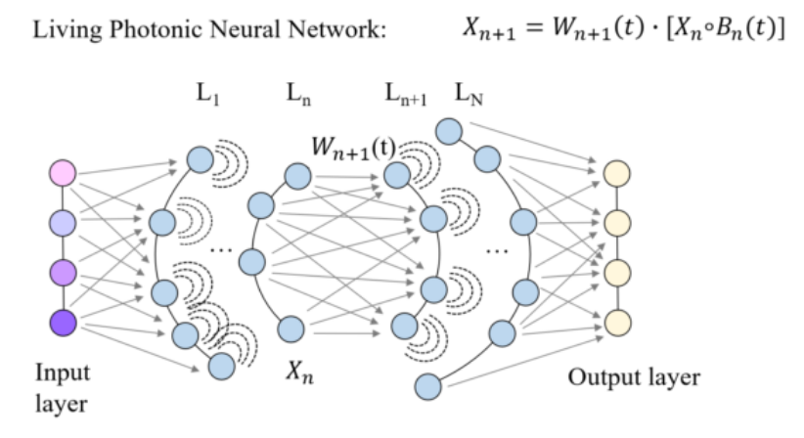
Lab and Research Introduction
Addressing Current Challenges (cont.)
However, ML methods:
Require significant resources to produce large quantities of training data. However, this:
is a one-time cost.
would otherwise require the same amount of simulations to achieve design goals.
Key differentiator of ML: simulations are invested into building the design tool, while they are wasted/consumed otherwise.
Building a NN (left) that gets better over time (right)*.
*J. Peurifoy, et al., Nanophotonic Particle Simulation and Inverse Design Using Artificial Neural Networks, Science Advances, 2018.

Slide 6
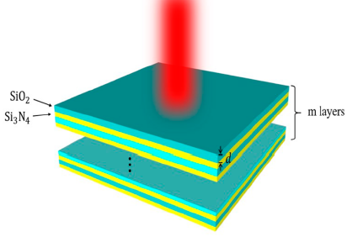
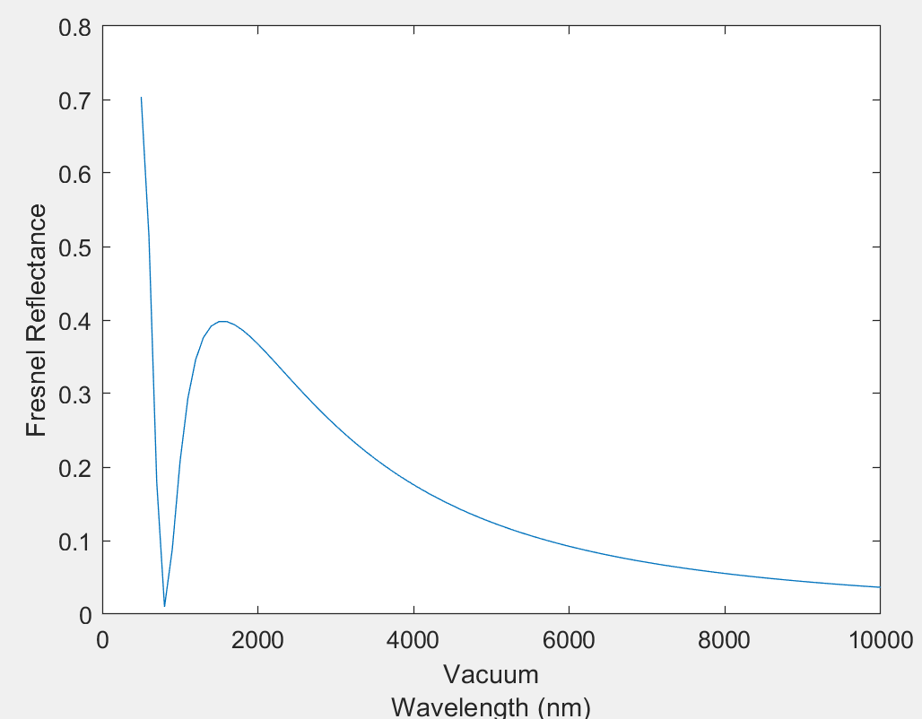
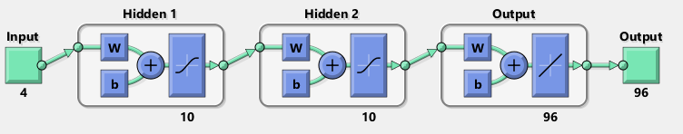
Lab and Research Introduction
Demonstration – Artificial Neural Network (ANN)
Training Data:
4 inputs (alternating layers from 30-80 nm thick; 10 nm steps)
96 outputs (points of reflectance spectra from wavelengths 500 nm to 10,000 nm; 100 nm steps)
1296 total samples
Fixed refraction indices (1.5 and 2.5) and angle of incidence
Initial Network Architecture:
2 hidden layer, 20 neurons, ADAM method

Slide 7
Introduction to Machine Learning and Artificial Neural Networks (ANN)

Slide 8
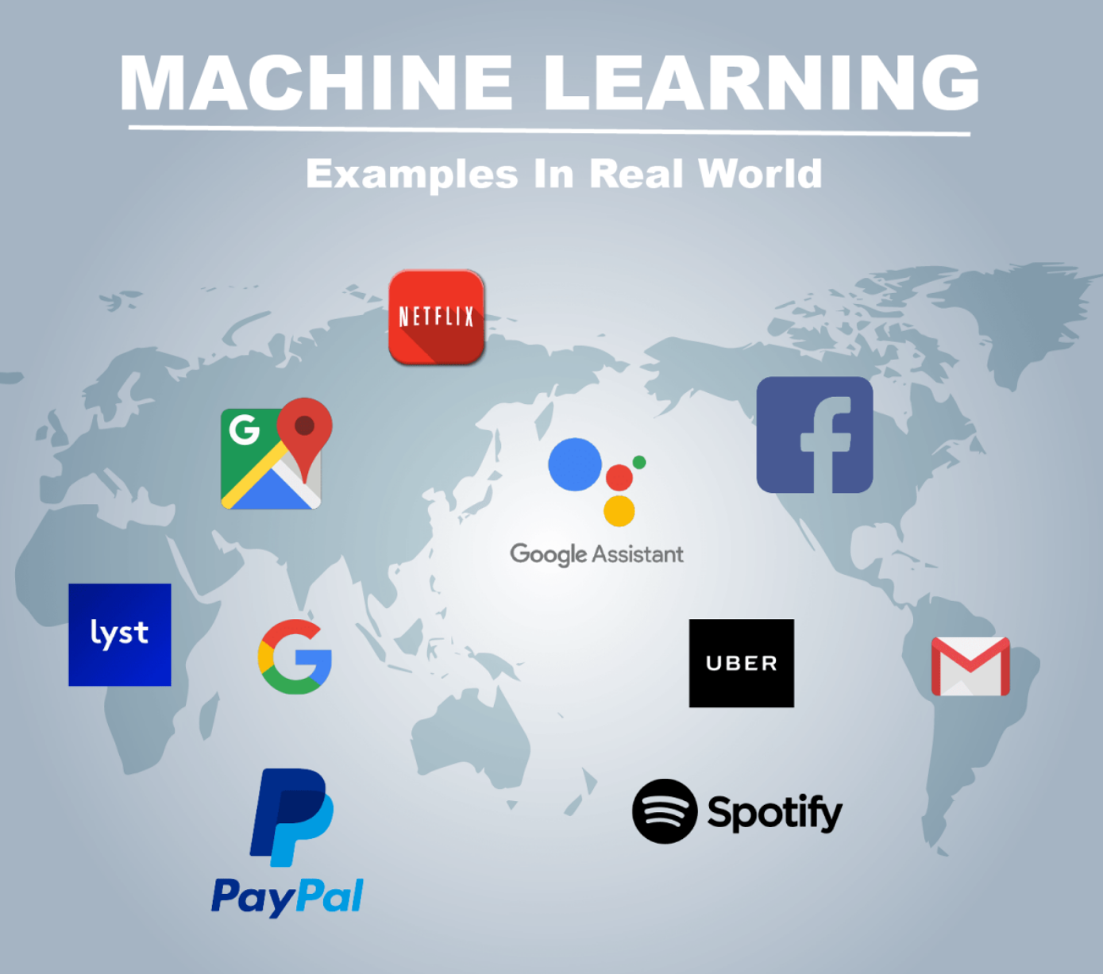


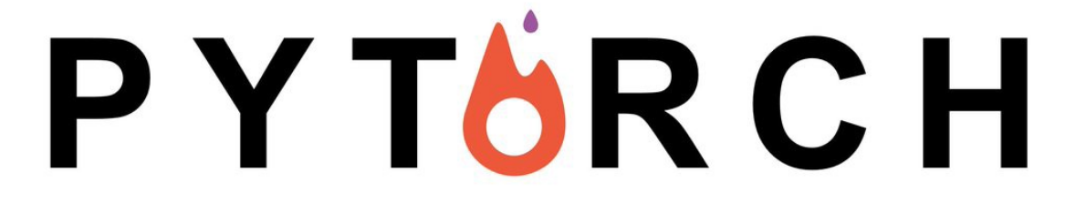
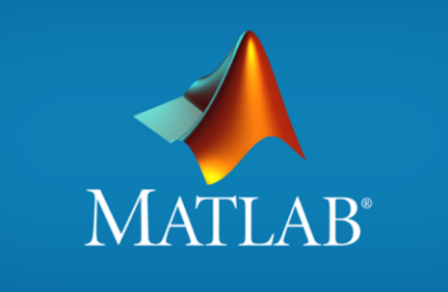
Introduction to Machine Learning
Machine Learning is All Around Us
Performing tasks without explicit instructions.
Relies on patterns from training data instead.
Deep Learning Frameworks
TensorFlow (Google)
PyTorch (Facebook)
MATLAB (MathWorks)
Machine Learning Applications*
Deep Learning Frameworks
*B. Bhagat, Machine Learning Examples (2019). Available at: https://cloud-techlife.com/2019/07/06/machine-learning-examples-part-2/

Slide 9
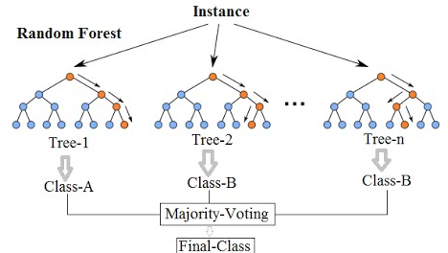
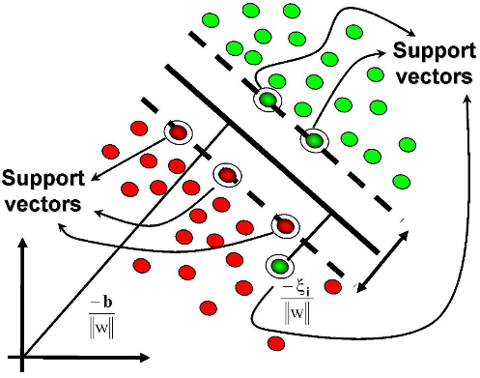
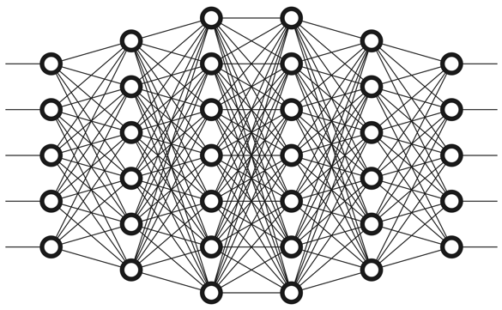
Introduction to Machine Learning
Types of Machine Learning Models*
Random Forest
Support Vector Machine
Deep Learning
Advantages:
Interpretability
Accurate for small datasets
Disadvantages:
Longer training time
Less accurate for large datasets
Advantages:
Memory efficient
Disadvantages:
Doesn’t perform well with overlapping/noisy data
Advantages:
Best performance for numerous domains
Disadvantages:
Requires large amount of data to perform better than other methods
Less interpretability
Han, T., et al., Comparison of random forest, artificial neural networks and support vector machine for intelligent diagnosis of rotating machinery. Trans. Inst. Meas. Control (2018).

Slide 10
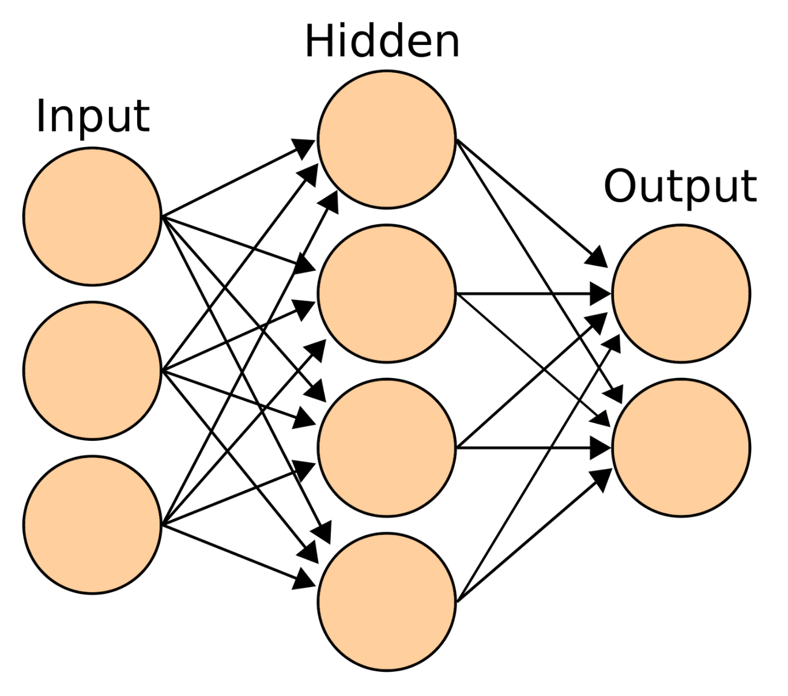

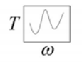
Introduction to Machine Learning
Artificial Neural Network

Slide 11
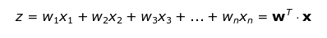
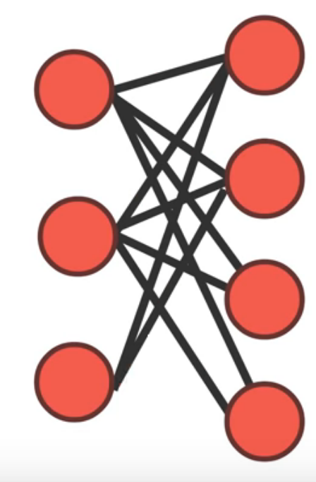
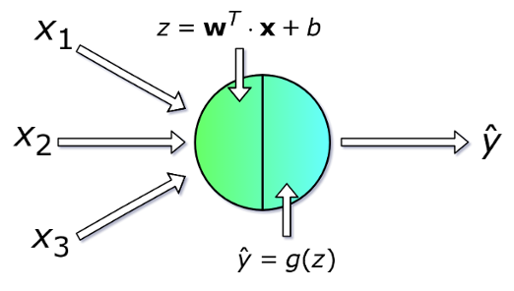
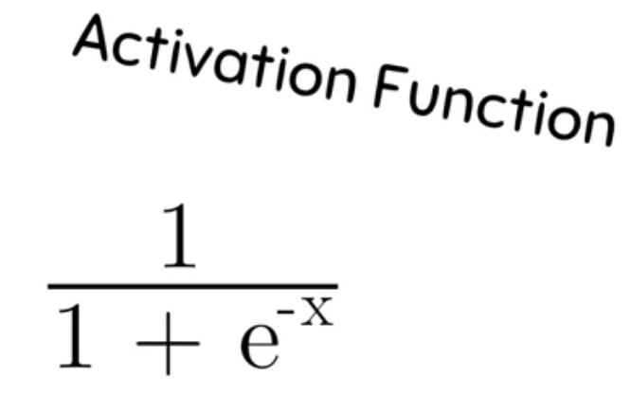
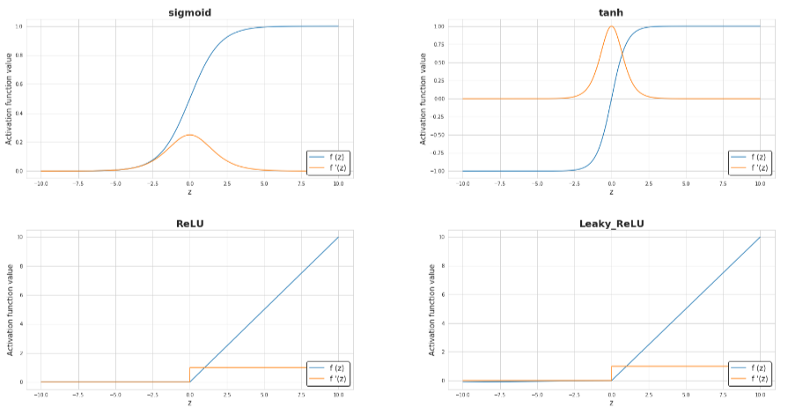
Introduction to Machine Learning
Feed Forward Phase*
Calculate neuron values with weights and biases:
Weighted Connections
*P. Skalski, Deep Dive into Math Behind Deep Networks, Towards Data Science (2018). Available at: https://towardsdatascience.com/https-medium-com-piotr-skalski92-deep-dive-into-deep-networks-math-17660bc376ba

Slide 12
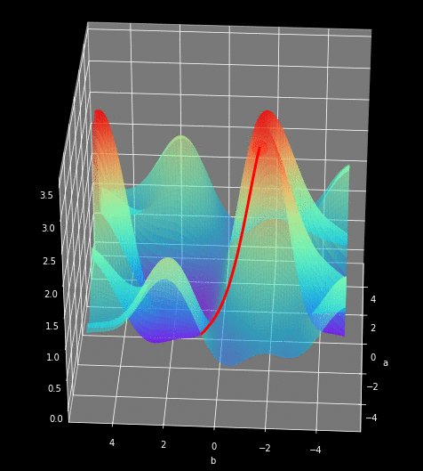
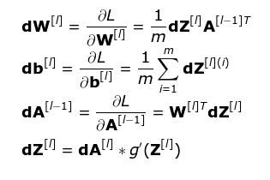
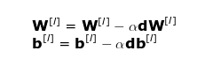
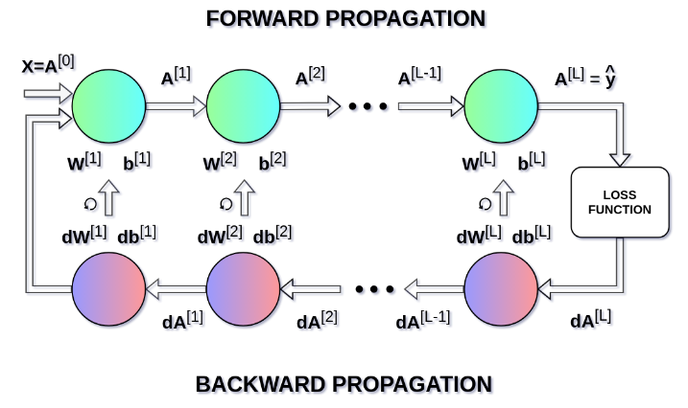
Introduction to Machine Learning
Back Propagation*
Adjust weights and biases based on the loss function (error):
1
1) Determine Loss
2) Determine magnitude of w & b change (gradient descent)
2
3) Update weights and biases
3
Repeat until error is minimized. One Epoch:
*P. Skalski, Deep Dive into Math Behind Deep Networks, Towards Data Science (2018). Available at: https://towardsdatascience.com/https-medium-com-piotr-skalski92-deep-dive-into-deep-networks-math-17660bc376ba

